Slide 1

Enhancing Blood Cancer Diagnosis through Advanced AI
Leveraging Convolutional Neural Networks for Clinical Accuracy
Nicholas Catani

Slide 2
Agenda
Business Understanding
Data Understanding & Preparation
Modeling
Training Process
Evaluation & Results
Recommendations
Ethical & Faith Implications

Slide 3



Business Understanding
Current diagnostic methods for blood cancer, such as microscopic examination and bone marrow biopsies, are time-consuming, invasive, and prone to variability
There exists a critical need for more objective, reliable, and non-invasive diagnostic technologies to address these limitations.
To harness the capabilities of advanced CNNs, specifically VGG16 and EfficientNetB3, to process and analyze clinical images for blood cancer diagnosis.
The aim is to improve the accuracy, efficiency, and timeliness of diagnostics, thereby enabling early and personalized treatment interventions and enhancing patient care.
Healthcare Providers
Medical researchers and academia
Patients
Healthcare technology companies
Health insurance providers
Regulatory bodies
Ethics committees
Data Science & AI community

Slide 4
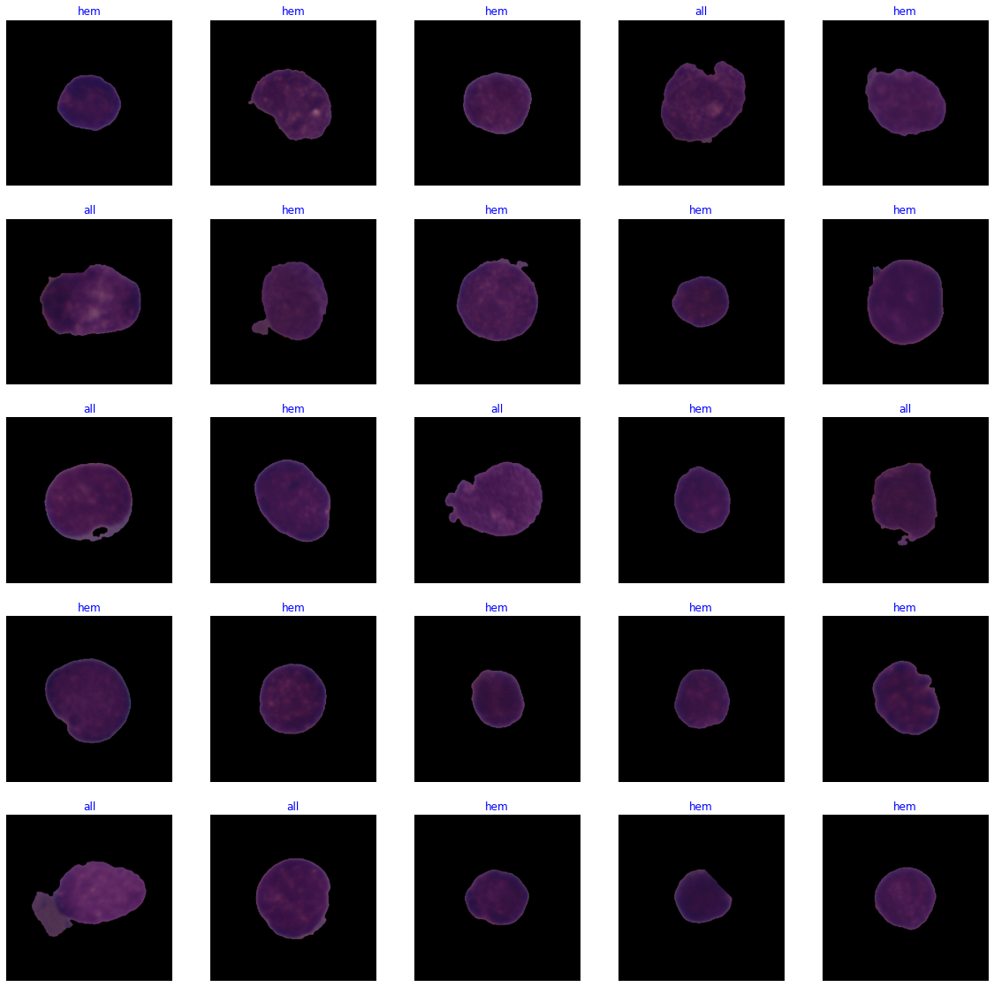
Data Understanding & Processing
Dataset It comprises 15,135 images derived from 118 patients, categorized into two labeled classes: Normal cells and Leukemia blasts.
Data Quality Issues Given the nature of medical images, staining noise and illumination errors are anticipated. Data augmentation techniques has been used to increase the robustness of the models.

Slide 5
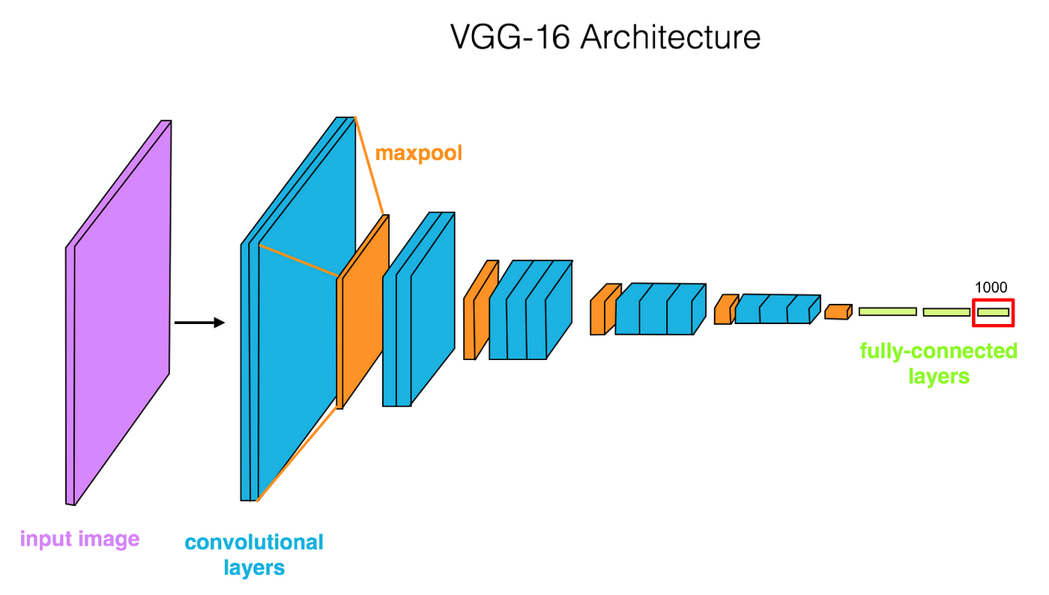
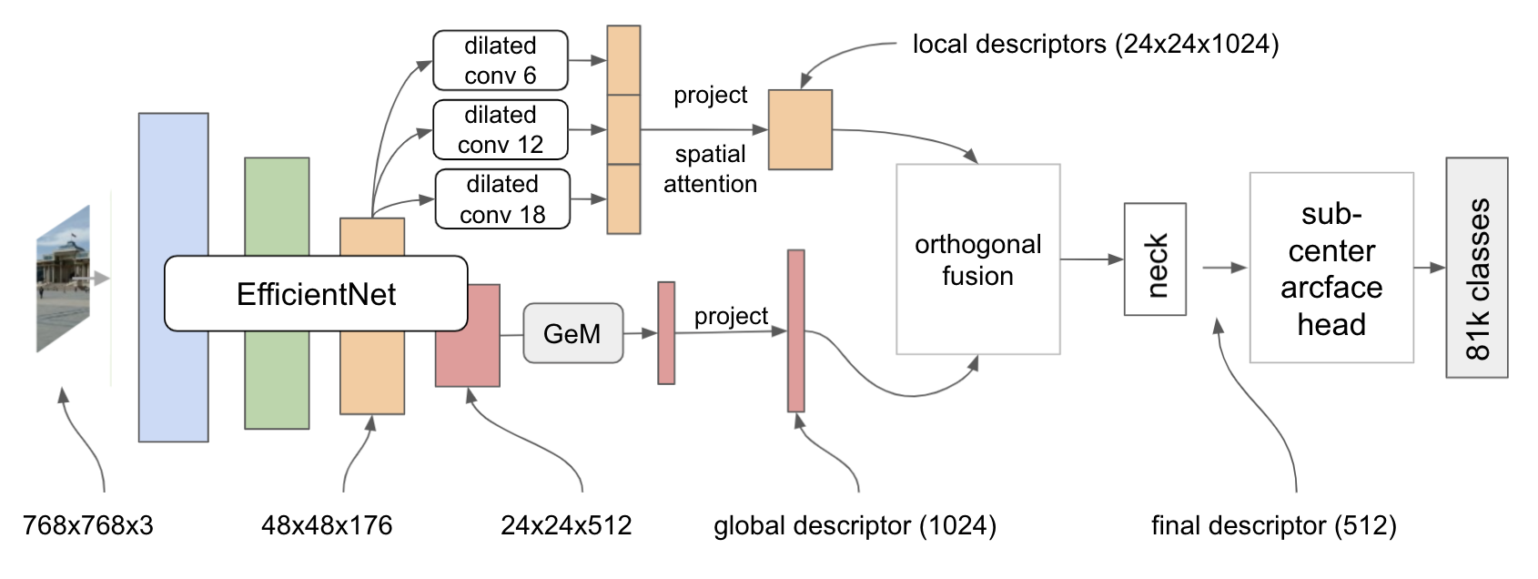
Modeling
VGG16
EfficientNetB3

Slide 6
Training Process

Slide 7
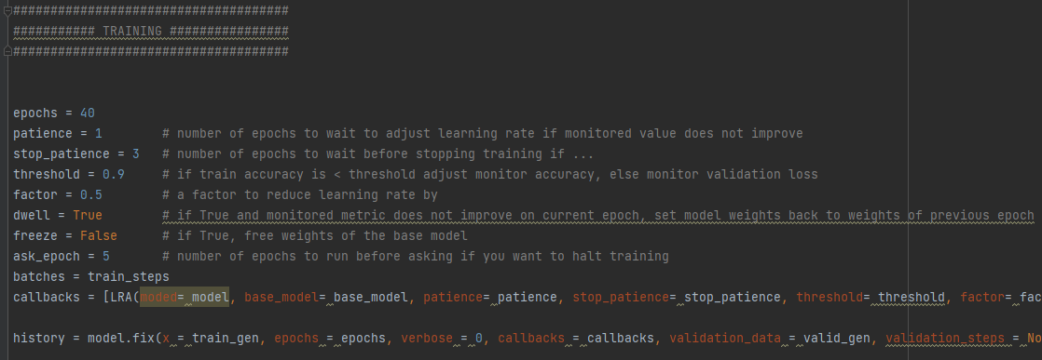

Slide 8
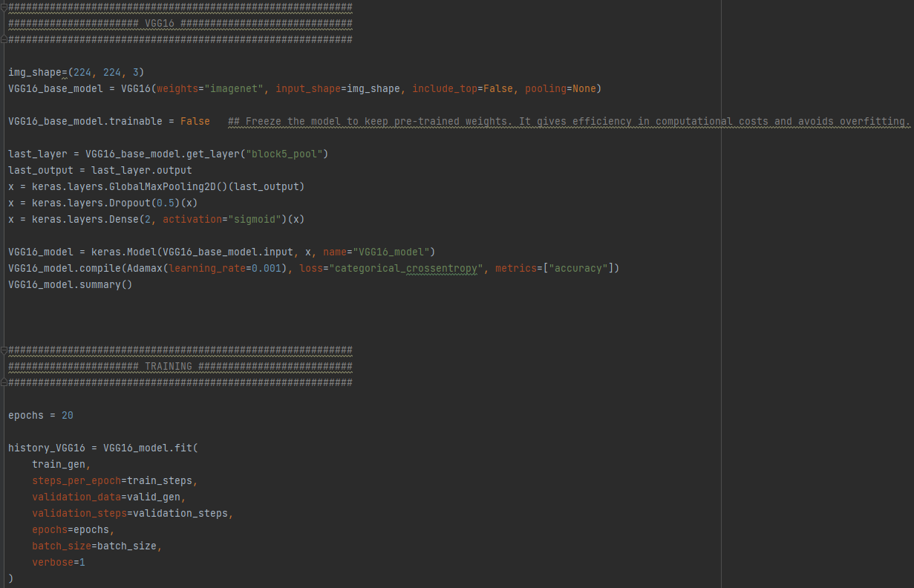

Slide 9
Evaluation & Results

Slide 10
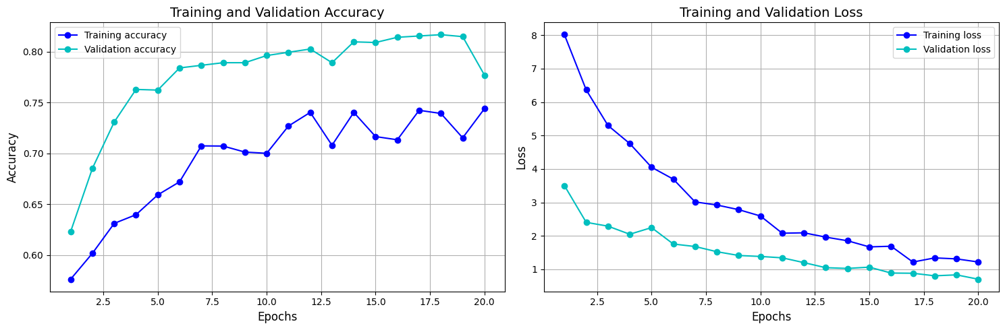
VGG16

Slide 11
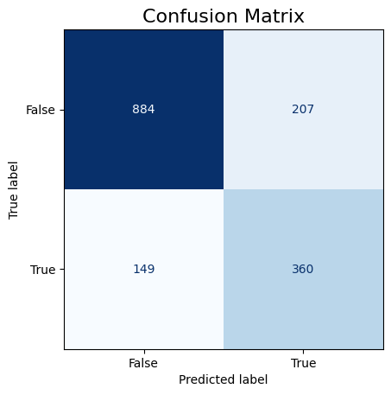
VGG16

Slide 12
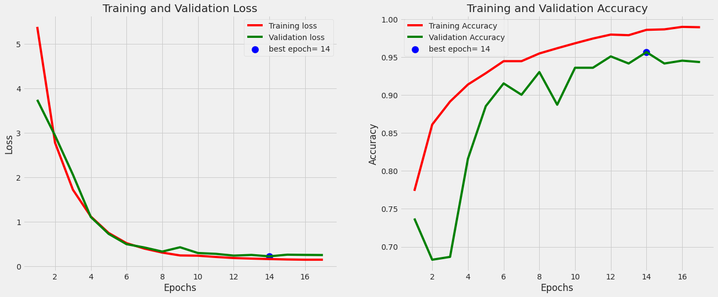
EfficientNetB3

Slide 13
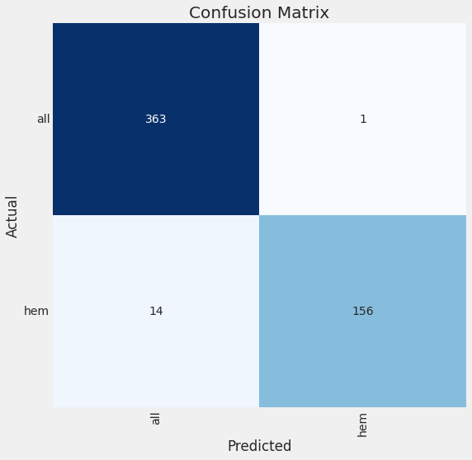
EfficientNetB3

Slide 14
Recommendations
Model Optimization
Data Augmentation & Quality
Data Enrichment & Balance
Ensemble Methods
Fine-tuning VGG16
Extending EfficientNetB3 Training
Enhanced Data Augmentation (rotations & zooming)
Advanced Pre-processing
Addressing Class Imbalances
Aggregating more Data
Exploring Ensemble Models

Slide 15
Ethical & Faith Implications
Strive for Accuracy
Data Privacy and Security
Equitable Access to Technology
Inherent Worth and Compassion
Honesty and Integrity
Stewardship and Resource Management
Balancing Technical Potential and Moral Considerations

